Slide 1


Department of Computer Science and Engineering
ONLINE HEALTHCARE SYSTEM AND
DNA ANALYSIS
MOHAN B / 211421104164
MADAN KUMAR P / 211421104147
KINGSLY JEFFRIN J / 211421104129
BATCH NO: D5
Mr. A. KARTHIKEYAN B.E., M.Tech,
SUPERVISOR

Slide 2
Abstract
This project is an advanced web-based healthcare management system designed to bridge the gap between hospitals, doctors, and patients while offering secure and efficient healthcare services. The platform allows hospitals to register, manage doctors, and define service costs. Patients can conveniently select hospitals, choose doctors, make secure payments, and receive a personalized Token to enable encrypted communication with their chosen doctor. Patients can upload DNA sequences, which doctors analyze using the Smith-Waterman algorithm to provide precise diagnostic results. An administrator oversees the platform to ensure streamlined operations and robust security compliance. To protect sensitive patient information, the system employs the AES encryption algorithm, safeguarding data confidentiality and integrity during storage and transmission. By integrating secure communication channels with advanced DNA analysis capabilities, the system offers fostering trust, security, and efficiency in medical services.

Slide 3
Introduction
The healthcare industry has seen significant advancements with the integration of technology, leading to more efficient and secure management of medical services.
This web-based healthcare management system aims to enhance the overall healthcare experience by connecting hospitals, doctors, and patients in a seamless and secure platform.
It facilitates hospital registration, doctor management, and service cost definitions, enabling patients to select hospitals and doctors based on their preferences.
By introducing encrypted communication via secure chat and token-based authentication, patients can interact with doctors in a private and protected environment.

Slide 4
Introduction
Furthermore, the system supports the upload of DNA sequences, which are analyzed using the Smith-Waterman algorithm, offering precise diagnostic results tailored to the patient's needs.
The use of AES encryption ensures that all patient data is securely stored and transmitted, preserving confidentiality and trust.
The system is monitored by an administrator to ensure smooth operations and compliance with security standards. This project aims to bridge the gap between medical providers and patients while fostering a secure, innovative, and efficient healthcare environment.

Slide 5
Objective of the Project
The primary objective of this project is to develop a secure and efficient web-based healthcare management system that enhances communication between patients and doctors.
The system aims to provide secure communication and utilizes AES encryption to ensure the protection of personal data.
The platform enables hospitals to register, manage doctor profiles, and set service costs, streamlining healthcare service management and delivery.
A key feature of the system is the ability for patients to share DNA sequences with doctors, allowing them to leverage the Smith-Waterman algorithm for accurate and personalized diagnostic results.

Slide 6
Literature Survey
S.NO | Title of the paper | Methodology | Advantages | Disadvantages
1. | DNA-Based Storage of RDF Graph Data: A Futuristic Approach to Data Analytics – (Asad Usmani and Lena Wiese) | This paper proposes using DNA as a storage medium for RDF (Resource Description Framework) graph data. It utilizes binary search to retrieve partial data by decoding fewer DNA strands, reducing sequencing costs. SPARQL queries are employed to efficiently retrieve data from large RDF datasets. | DNA storage offers a high-density, long-term solution for archiving digital data, significantly reducing the need for traditional storage methods. | DNA synthesis and sequencing remain costly and complex, limiting the scalability and widespread use of DNA storage systems.
2. | Join Classifier of Type and Index Mutation on Lung Cancer DNA Using Sequential Labeling Model – (Untari Novia Wisesty, Ayu Purwarianti, Adi Pancoro, Amrita Chattopadhyay, Nam Nhut Phan, Eric Y. Chuang, Tati Rajab Mengko) | The paper introduces a sequential labeling model that uses deep learning techniques like BiLSTM and Bi-GRU to classify DNA mutations (substitution, insertion, deletion, and delins) in lung cancer sequences. It does not require realignment of reference sequences for mutation detection. | The model achieves high accuracy and faster processing for mutation detection, without needing to realign reference sequences, making it more efficient. | It requires large annotated datasets and significant computational resources, which can be challenging for real-time applications in clinical settings.

Slide 7
3. | U.S. Adult Perspectives on Facial Images, DNA, and Other Biometrics – (Sara H. Katsanis, Peter Claes, Megan Doerr, Robert Cook-Deegan, Jessica D. Tenenbaum, Barbara J. Evans, MyoungKeun Lee, Joel Anderton, Seth M. Weinberg, Jennifer K. Wagner) | The study surveys 4048 U.S. adults, assessing their comfort and trust in providing facial and DNA biometrics in various scenarios. It examines factors like perceived effectiveness and acceptance of biometric data usage across different tasks and privacy concerns. | The survey provides useful insights into public perceptions of biometrics, helping shape informed policy decisions regarding biometric data usage | The study's focus on the U.S. population and reliance on self-reported data may limit its generalizability to other regions or real-world behaviors.
4. | DNA Privacy: Analyzing Malicious DNA Sequences Using Deep Neural Networks – (Ho Bae, Seonwoo Min, Hyun-Soo Choi, Sungroh Yoon) | This paper proposes a deep learning approach to detect malicious DNA sequences that may contain hidden data (steganography). It uses neural networks to classify DNA sequences as coding or non-coding and identifies if hidden, harmful data is present. | It offers an effective method to protect DNA data from malicious alterations and steganography, enhancing DNA data privacy. | The method requires substantial computational resources and large datasets for training the neural networks, which may limit its real-time applicability.

Slide 8
5 | Vivern–A Virtual Environment for Multiscale Visualization and Modeling of DNA Nanostructures (David Ku tak ,Matias Nicolas Selzer , Jan By ska , Marı´a Lujan Ganuza , Ivan Bari sic , BarboraKozlıkova , and Haichao Miao) | Vivern involves creating a VR application that provides abstract visual representations and tools for examining DNA nanostructures, such as the Magic Scale Lens and DNA Untwister, to support detailed analysis. The platform allows experts to design and manipulate DNA structures within a shared VR environment, enhancing spatial exploration and collaboration. | Vivern enables more intuitive, spatial analysis of complex DNA nanostructures, overcoming the limitations of desktop tools. It supports detailed design and collaboration in a virtual environment, enhancing research and development. | Vivern may require specialized VR hardware, limiting accessibility for some users. Additionally, its reliance on VR technology could pose a learning curve for those unfamiliar with immersive environments.

Slide 9
Problem Statement
The healthcare industry faces significant challenges in providing seamless, secure, and efficient communication and service delivery between hospitals, doctors, and patients.
Traditional systems often lack the necessary integration to streamline the management of healthcare services, creating barriers to access, reducing the quality of care, and compromising patient security.
Furthermore, advancements in medical technologies, such as DNA sequencing, have not been fully leveraged in many healthcare platforms. There is also a critical need for secure communication channels that protect sensitive patient data while enabling consultations.

Slide 10
Existing System
DNA sequence coding is the major problem, since the quantity and quality of the generated DNA sequence have a strong influence on the reliability and accuracy of DNA computing .
Generally, low similarity and low melting temperature are required to reduce the probability of mismatch hybridization and to increase the reaction efficiency .
For instance, we consider 2 DNA strands X1 and X2, and they hybridize with each other. In the previous work, researchers generally considered six constraints, and they are melting temperature (Tm), GC base content (GC), Continuity (Con), Hairpin structure (Hair), Similarity (Sim) and H-measure (Hm).
To achieve the objective of low mismatch, false negative and false positive hybridization should be prevented in DNA sequences generation. Moreover, in order to improve the efficiency of reaction.

Slide 11
Proposed System
The proposed system is a comprehensive web-based healthcare platform designed to provide an efficient, secure, and user-friendly environment for hospitals, doctors, and patients.
The system facilitates the registration of hospitals and doctors, enabling hospitals to manage their doctor profiles, set service costs, and offer detailed healthcare services to patients.
For patients, the system provides a seamless experience where they can browse available hospitals, select doctors, and make secure payments for medical services.
Once a service is booked, patients receive a personal Token for secure communication with their doctor, ensuring privacy and confidentiality.

Slide 12
Proposed System
The system allows patients to share their DNA sequences with doctors, who will analyze the data using the Smith-Waterman algorithm to provide diagnostic results.
Doctors have access to a chat interface where they can interact with patients, discuss diagnoses, and provide personalized medical advice.
The platform also includes administrative controls to ensure smooth operation, monitor hospital and doctor registrations, and enforce security standards.

Slide 13
Software Configuration
H/W SYSTEM CONFIGURATION:
Processor: i3, i5, i7
RAM: 4 GB
Hard Disk: 260 GB
S/W SYSTEM CONFIGURATION:
Operating System: Windows 7/8/10
Front End: HTML & JSP
Back End: JAVA
Database: MySQL
Tool: NetBeans

Slide 14
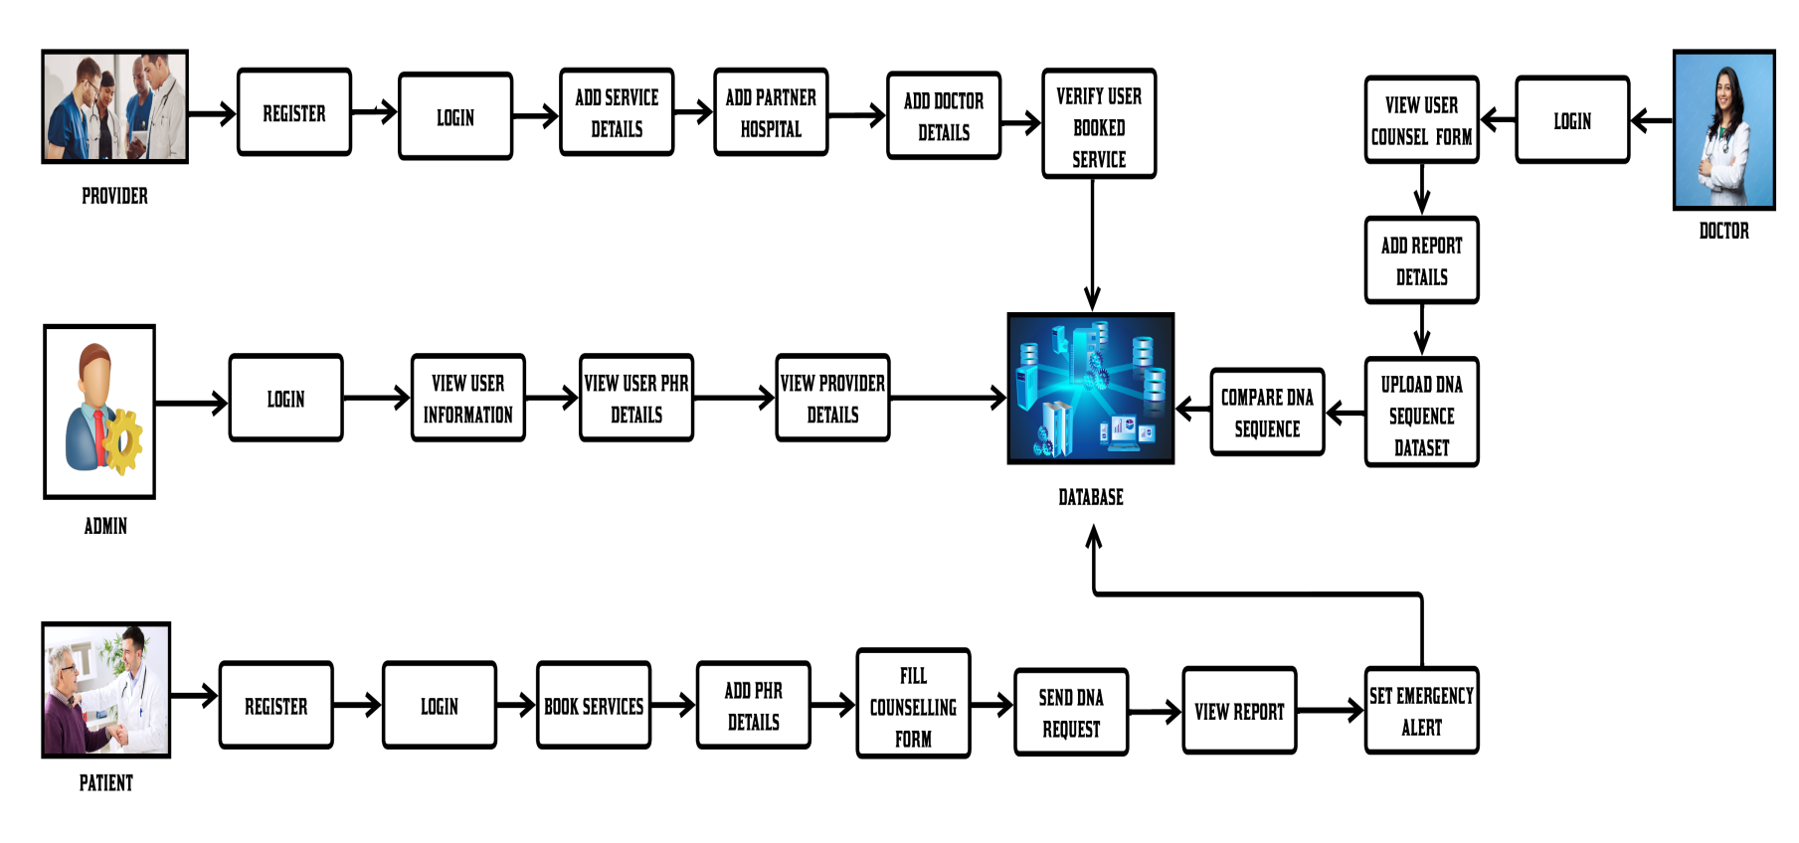
Architecture Diagram

Slide 15
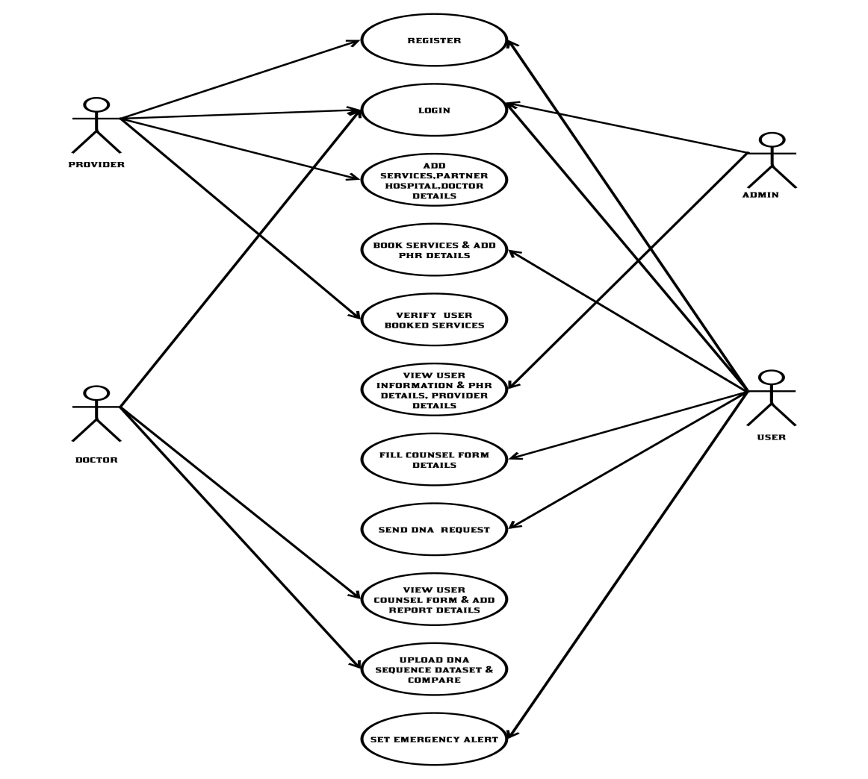
System Design- Use Case Diagram

Slide 16
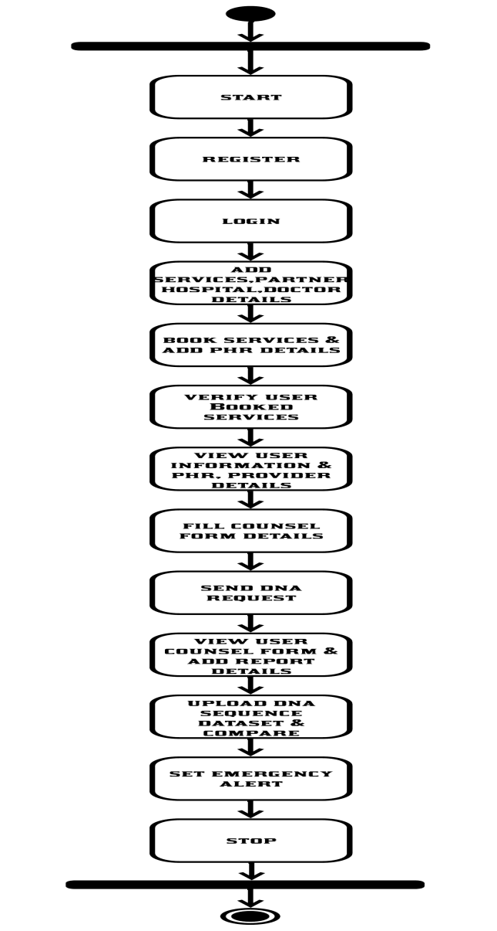
Activity Diagram

Slide 17
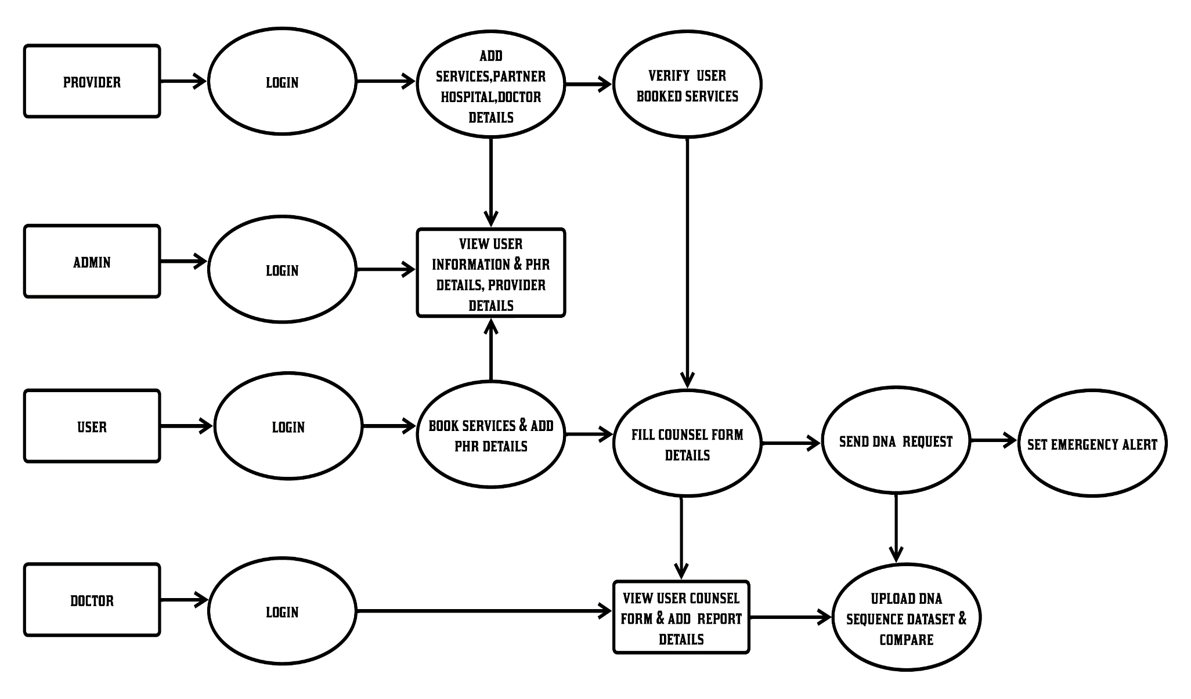
Data Flow Diagram - OVERALL

Slide 18
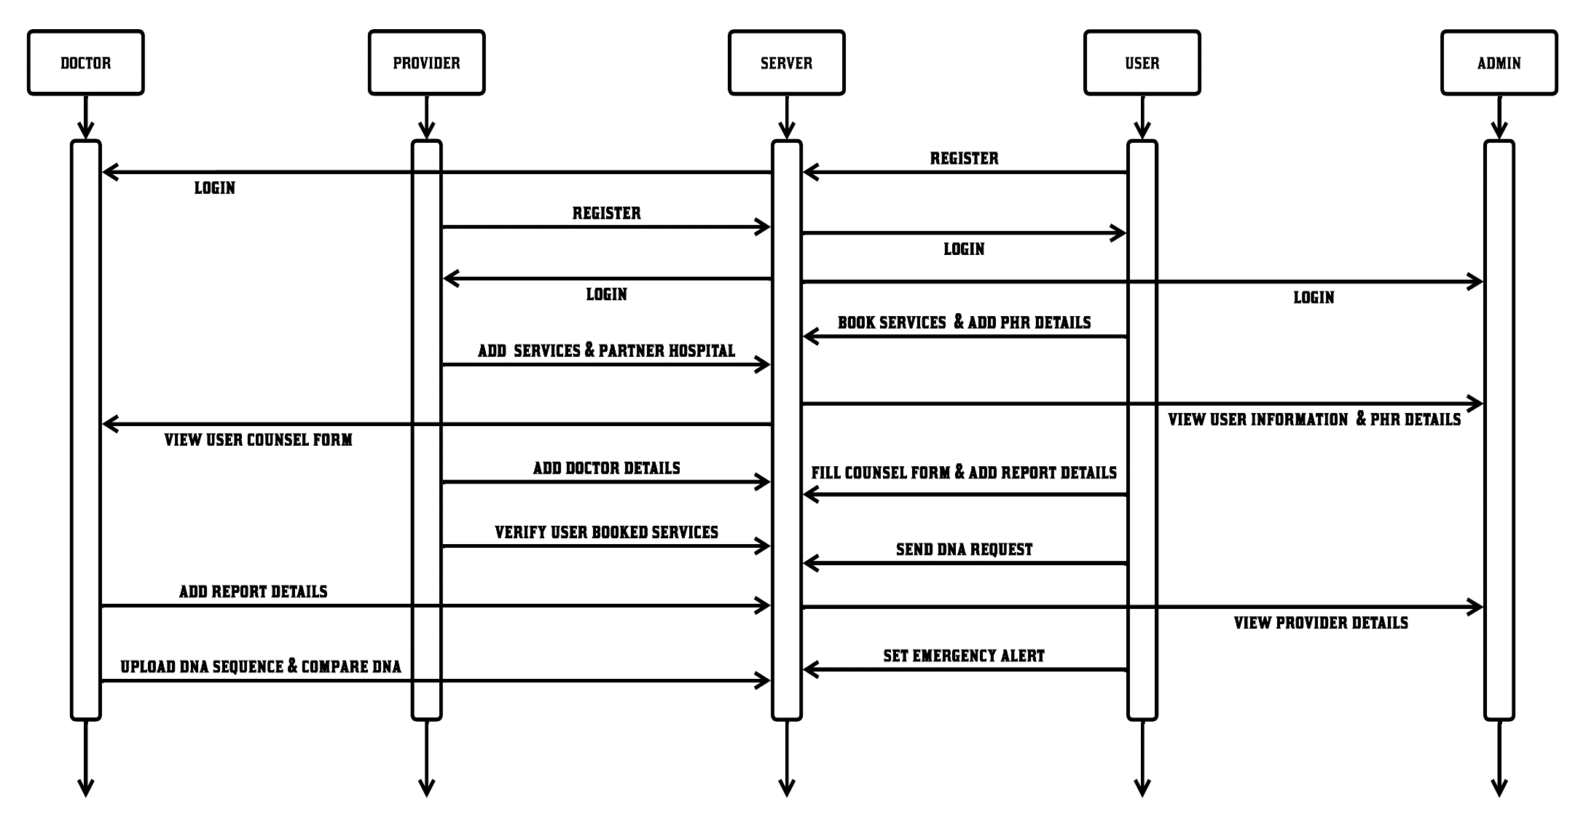
Sequence Diagram

Slide 19
Module Description
1. ADMIN UPLOAD :
In this module, a user must be authorized in the application to access its features.
On the provider side, hospitals and doctors must be added for further counseling of patients or users.
Doctor profiles are managed securely, ensuring that only doctors can access their counseling information using a password known only to them.
2. REPORTS UPLOAD :
In this module, when a user books a provider along with hospital facilities and a specialist doctor in the application, the booking process is completed.
Once the user returns for further consultation, they can proceed with counseling sessions with the specific doctor they selected.

Slide 20
Module Description
3. AGGREGATE QUERIES :
In this module, important queries often involve determining how many records contain a diagnosis of a disease and a gene variant.
The system enables secure outsourcing of the database, allowing such queries without requiring the server to decrypt the data.
Hospitals will store DNA data as a large sequence of characters from an alphabet representing the four nucleotide types.
This alphabet can be extended with additional characters representing augmented sequences for enhanced analysis.
4. SEQUENCE TESTING:
In this module, queries on DNA need to account for various errors, such as irrelevant mutations, incomplete specifications, and sequencing errors.
Clients are authorized entities, meaning they are allowed to perform queries on the encrypted DNA sequences.

Slide 21
Module Description
5. SET MATCH QUERY:
In this module, we will authenticate that the query asked by the researcher matches the query provided by the cloud.
The hospital will set the alphabetical sequence of DNA, and the same alphabetical sequence must be provided by the researchers for consistency.
6. HIDING FROM THE DECRYPTING SERVER:
In this module, the hospital will store the encrypted file on the cloud.
The cloud will internally designate cloud1 as the key holder and cloud2 as the data holder.
Each time a researcher queries the file, cloud1 will return the key.
If the key matches with the hospital's secret key, cloud2 will return the decrypted data.

Slide 22
Performance Evaluation / Results
The performance analysis of the proposed system evaluates its efficiency, security, and scalability in handling healthcare data, encrypted communication, and DNA sequence analysis.
The system ensures fast and secure authentication through optimized encryption algorithms, minimizing login and access delays.
DNA sequence analysis using the Smith-Waterman algorithm is computationally intensive but is optimized for efficient processing, ensuring rapid diagnosis while maintaining accuracy.
The AES encryption module protects patient data without significantly affecting system performance, as encryption and decryption processes are lightweight and optimized for real-time operations.

Slide 23
Performance Evaluation / Results
Secure aggregate queries enable efficient data retrieval while preserving privacy, ensuring minimal query execution time even with large datasets.
The cloud-based infrastructure enhances scalability, allowing seamless handling of increasing user loads without performance degradation.
System responsiveness is maintained through optimized database queries and load balancing mechanisms.
Overall, the system provides a highly secure, efficient, and scalable solution, ensuring fast healthcare service delivery while maintaining strict data privacy and security standards.

Slide 24
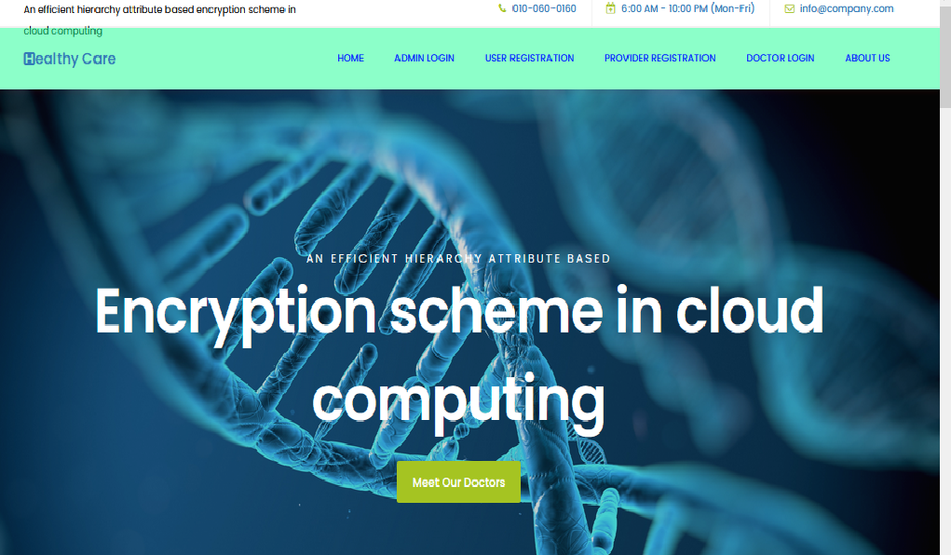
Screen Shots
Home Login

Slide 25
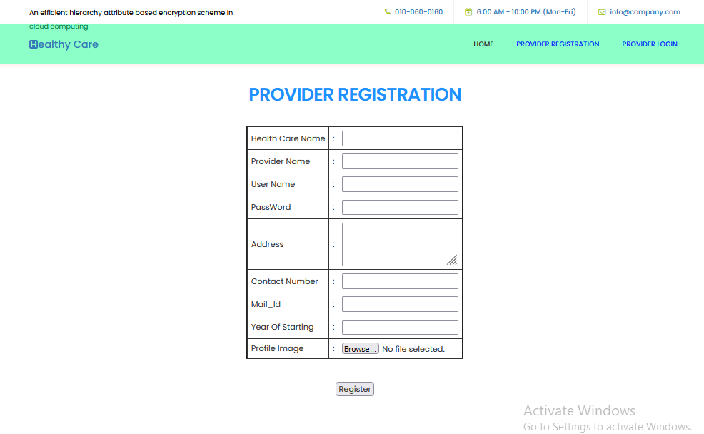
Screen Shots
PROVIDER REGISTRATION

Slide 26
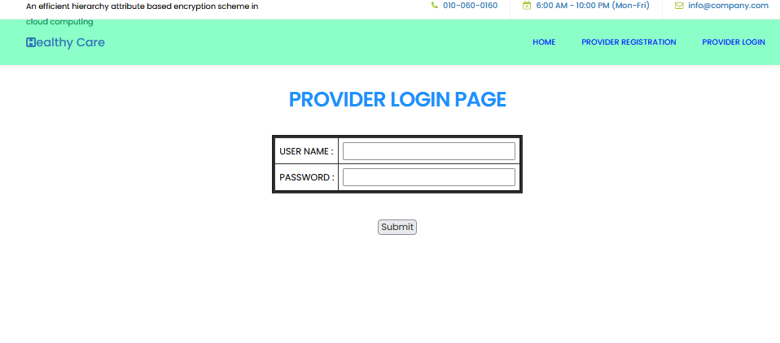
Screen Shots
PROVIDER LOGIN PAGE

Slide 27
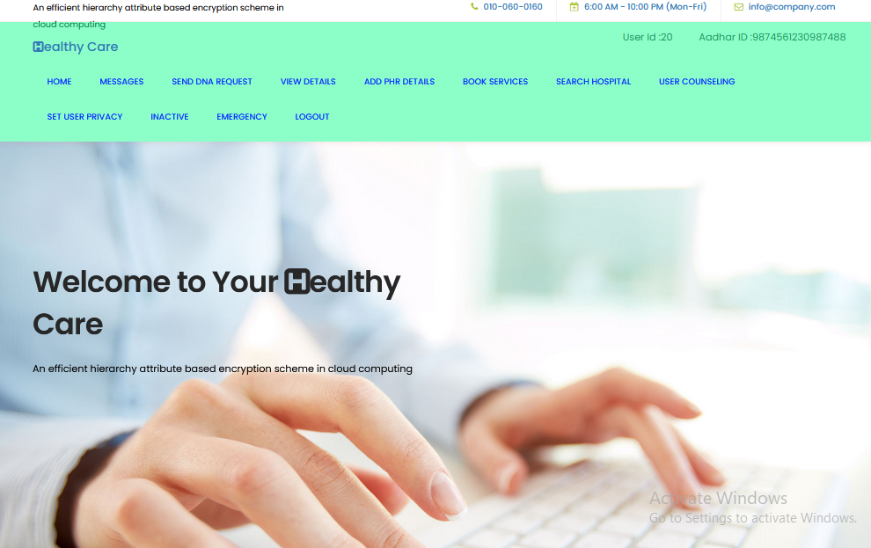
Screen Shots
USER HOME PAGE

Slide 28
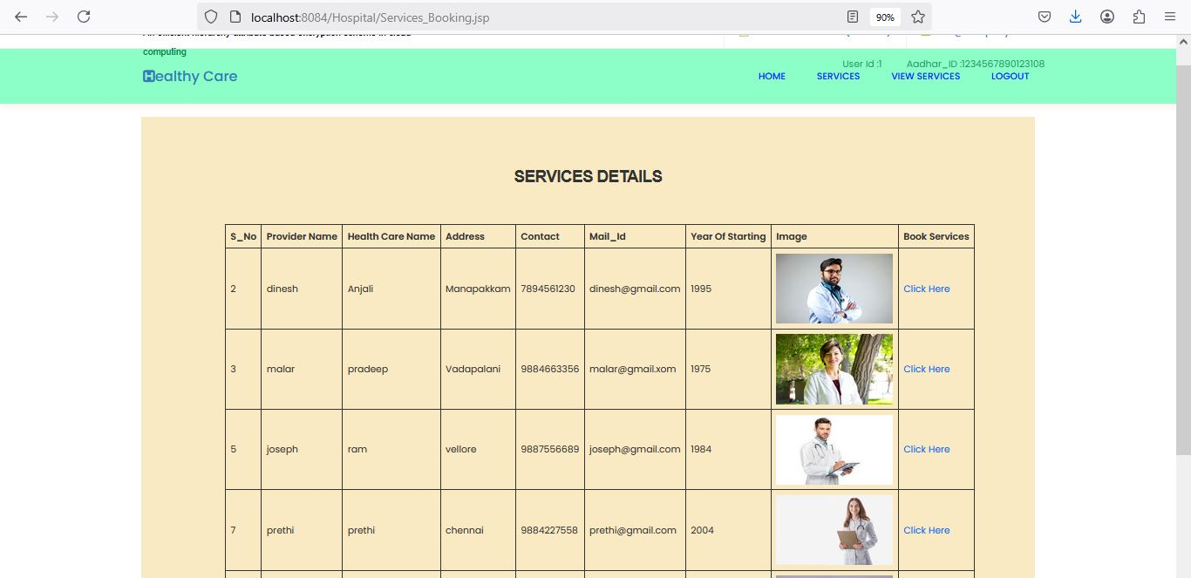
Screen Shots
VIEW SERVICE DETAILS PAGE

Slide 29
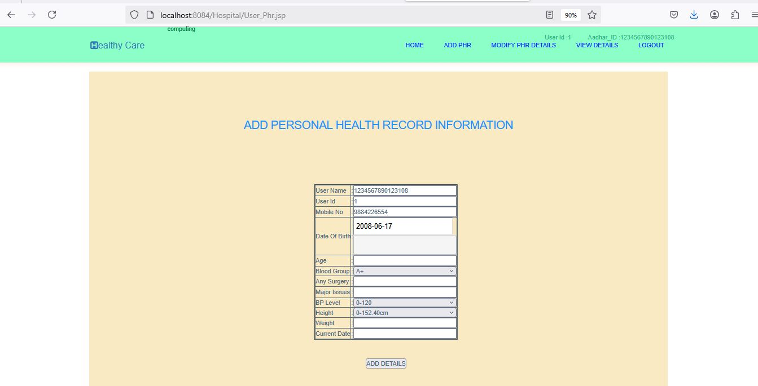
Screen Shots
ADD HEALTH RECORD DETAILS

Slide 30
Conclusion / Feature Enhancement
In conclusion, the proposed web-based healthcare management system offers efficient, and user-friendly solution for enhancing the interactions between hospitals, doctors, and patients.
By integrating features such as communication, DNA sequence analysis using the Smith-Waterman algorithm, and an intuitive interface, the system ensures that both patients and doctors can communicate.
The use of AES encryption provides robust security, protecting personal data, while the platform's administrative controls ensure seamless operation and regulatory compliance.
This system not only improves the quality of healthcare services by enabling personalized diagnostic solutions but also streamlines the management of healthcare services for hospitals and doctors.

Slide 31
Conclusion / Feature Enhancement
Furthermore, the system is scalable and can be expanded to incorporate future technologies By combining innovative technology with a focus on security and ease of use, the system promises to significantly improve healthcare delivery, enhance patient trust, and create a more efficient medical service ecosystem.
Big data analytics over genetic data is a good future work direction. There are rapid recent advancements that address performance limitations of homomorphic encryption techniques. We hope that these advancements will lead to more practical solutions in the future that can handle larger-scale genetics data. It is worth mentioning that our approach is not restricted to a fixed homomorphic encryption technique and therefore, it would be possible to use and inherit the advantages of newly developed ones.

Slide 32
Reference Paper
[1] ASAD USMANI AND LENA WIESE, “DNA-Based Storage of RDF Graph Data: A Futuristic Approach to Data Analytics,” VOLUME 11,November2023.
[2] UNTARI NOVIA WISESTY, AYU PURWARIANTI, ADI PANCORO , AMRITA CHATTOPADHYAY , NAM NHUT PHAN , ERIC Y. CHUANG , AND TATI RAJAB MENGKO, “Join Classifier of Type and Index Mutation on Lung Cancer DNA Using Sequential Labeling Model,” VOLUME 10,January2022.
[3]Sara H. Katsanis , Peter Claes , Megan Doerr , Robert Cook-Deegan , Jessica D. Tenenbaum , Barbara J. Evans , MyoungKeun Lee, Joel Anderton, Seth M. Weinberg , and Jennifer K. Wagner, “U.S. Adult Perspectives on Facial Images, DNA, and Other Biometrics.,” VOLUME 3,MARCH 2022.
[4]Ho Bae ,Seonwoo Min , Hyun-Soo Choi , and Sungroh Yoon, “DNA Privacy: Analyzing Malicious DNA Sequences Using Deep Neural Networks,” VOLUME 19,March2022.
[5]David Ku tak , Matias Nicolas Selzer , Jan By ska , Marı´a Lujan Ganuza , Ivan Bari sic , BarboraKozlıkova , and Haichao Miao, “Vivern–A Virtual Environment for Multiscale Visualization and Modeling of DNA Nanostructures.,” VOLUME 28,DECEMBER2022.

